Slide 1
Software and Other Cultural Artifacts
Barry Smith

Slide 2
Why the ontology of software is important
An example:
Digital Rights Management
Is Word 3.1 the same piece of software as Word 3 ?
Digital Object Identifiers (DOI)

Slide 3
Indecs Framework
What an entity is made up, its “stuff”, depends on the use to which the corresponding DOI system is being put.
All things are objects of perception
Axiom 5: “Everything is a view”

Slide 4
creator =def. A party contributing to the making of an original creation, in whole or in part
creation =def The output of creative activity
input =def A pre-existing entity which participates in a relation in a passive, qualifying or supportive role
original creation =def A creation without a source input

Slide 5
Indecs
The Mona Lisa is not an original creation – it used a certain lady as input
No painting is an original creation, since every painting involves the use of a paintbrush as input

Slide 6
Can we do better?

Slide 7
Searle’s ontology of the social world
X counts as Y in context C
this man counts as a president
this building counts as a cathedral
this lump of stone counts as a statue
this piece of paper counts as a set of instructions to be executed after my death
Searle, The Construction of Social Reality, 1987

Slide 8
The counts as formula applies to occurrents also
this audio-acoustic blast counts as a promise
this smashing of a bottle of champagne counts as a naming of a ship
this lifting of the hand counts as making a bid

Slide 9
X counts as Y in context C
X and Y are one and the same part of physical reality
which fall under different descriptions
X
Y

Slide 10
X counts as Y in context C
What about the money in your (electronic) bank account?
your money
blips in the
computer

Slide 11
Turtles
    It could not be that the world consists of institutional facts all the way down, with no brute reality to serve as their foundation.

Slide 12
Turtles
    Searle: wherever a status-function is imposed there has to be something it is imposed upon
    Eventually the hierarchy must bottom out in brute facts = phenomena whose existence is not a matter of human agreement.

Slide 13
The Construction of Social Reality:
    all sorts of things can be money, but there has to be some physical realization, some brute fact
    – even if it is only a bit of paper or a blip on a computer disk –
    on which we can impose our institutional form of status function.

Slide 14
But
    Does a blip on a computer disk really count as money?
    Do we truly impose status functions on blips in computers?
    Can we use blips in computers to buy things with?

Slide 15
representation
the money in your bank account is represented by blips in the bank’s computer

Slide 16
Searle:
    “On at least one point … the account I gave in [The Construction of Social Reality] is mistaken.
    “I say that one form that money takes is magnetic traces on computer disks, and another form is credit cards.”

Slide 17
Computer blips + credit cards
“Strictly speaking neither of these is money, rather, both are different representations of money.”

Slide 18
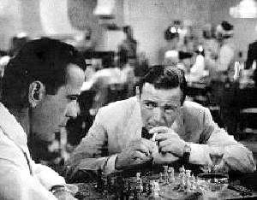
The ontology of chess

Slide 19
A game of chess
physical
movements
of physical
pieces of
wood

Slide 20
A game of chess
thoughts
physical
movements
of physical
pieces of
wood

Slide 21
A game of chess
thoughts
thoughts
physical
movements
of physical
pieces of
wood

Slide 22
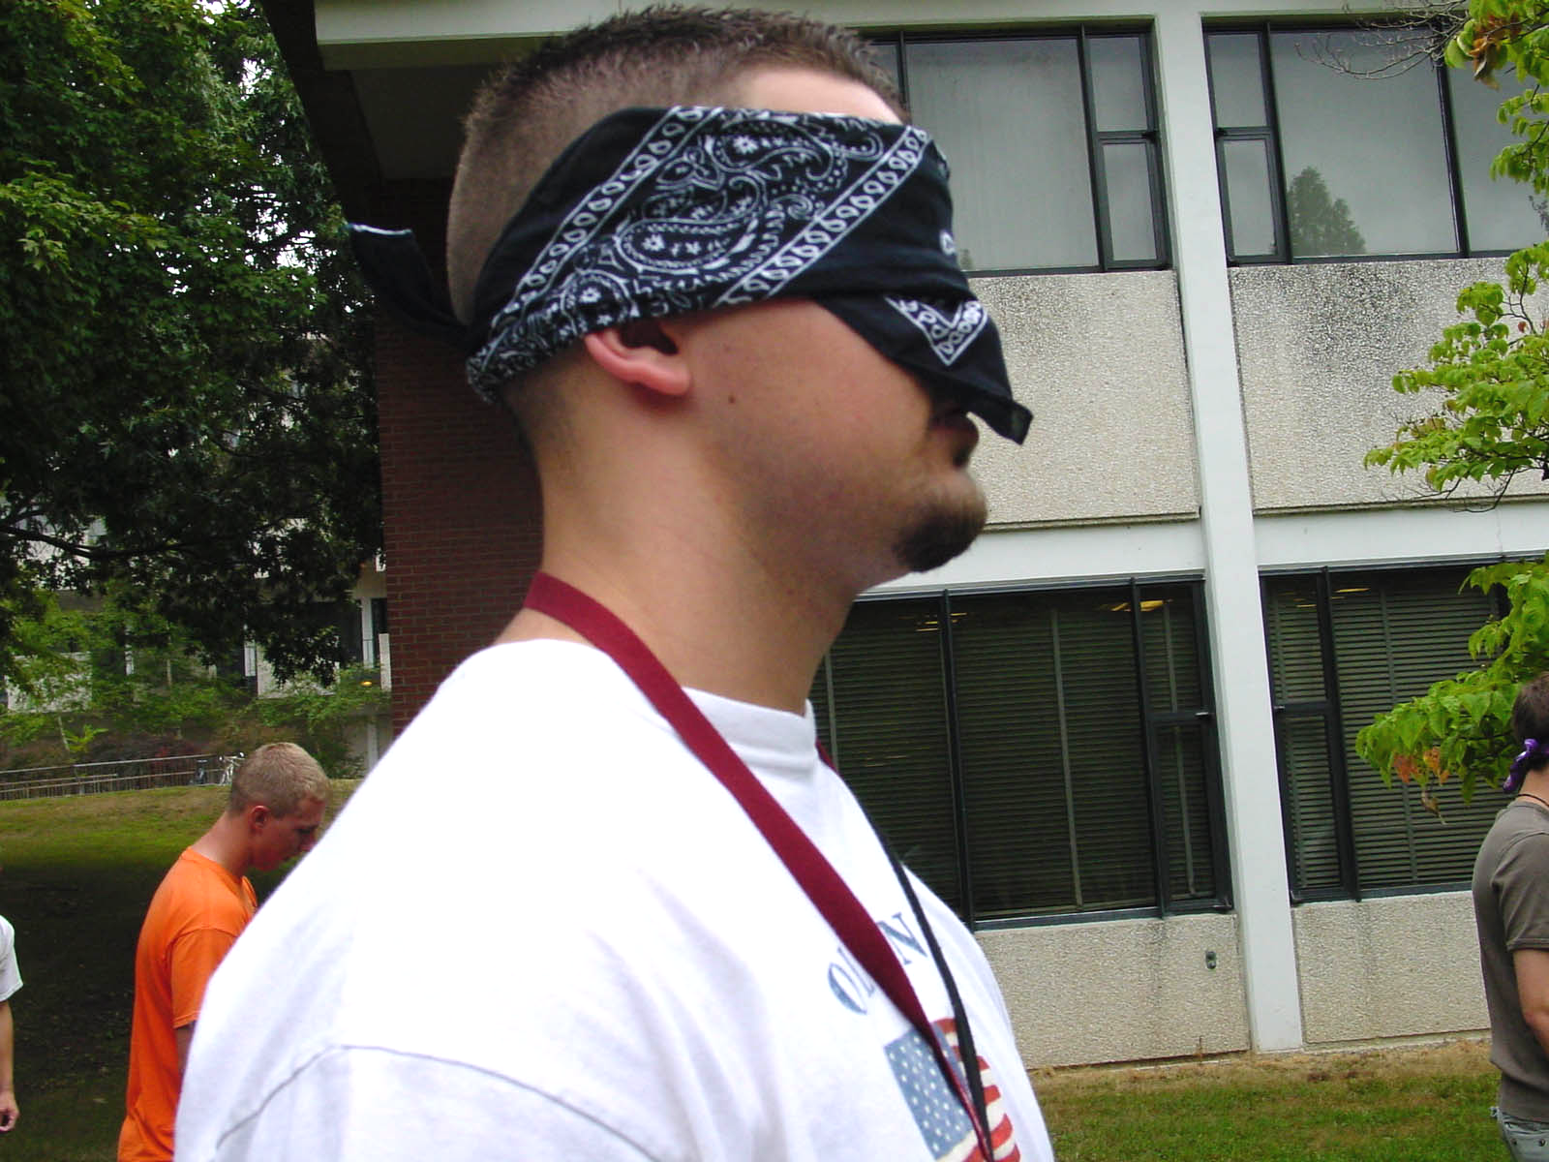
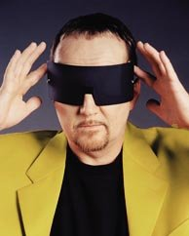
A game of blind chess
thoughts
thoughts
?

Slide 23
A Game of Blind Chess
something non-physical
– the thoughts and utterances are not parts of the game (they are representations)
– what then is the game?
some ideal Platonic pattern?
nothing at all? (fictionalism)

Slide 24
A Game of Blind Chess
is something non-physical
something like: an abstract pattern, that is at the same time tied to specific players and to a specific occasion
and to the specific history of the planet

Slide 25
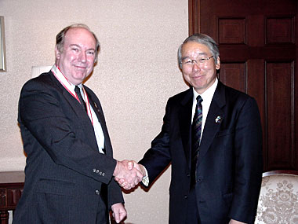
A Debt
an abstract pattern
tied to specific parties and to a specific initiating event
(records)
thoughts,
worries
thoughts

Slide 26
A Debt
an abstract pattern
tied to specific parties and to a specific initiating event
(records)
nothing here
thoughts,
worries
thoughts

Slide 27
Two sorts of social reality
presidents, driving licenses, cathedrals, spoken promises, bids at auctions, …
debts, blind chess games, money in your bank account, …
= free-standing Y terms – no underlying physical X with which Y is identical

Slide 28
Free-Standing Y Terms
are entities of a third kind:
there are neither real, physical entities
nor abstract, Platonic entities existing outside time and space
but abstract entities tied to history and to specific contexts of human behavior

Slide 29
Free Standing Y Money
does not tarnish
does not burn
is not subject to physical processes
its existence in time rather has the form:
exists
does not exist
does not exist

Slide 30
Three aspects of Platonism
abstract
uncreated
repeatable
debts, wills not repeatable
software, chess game repeatable

Slide 31
historico-cultural entities, often with quasi-mathematical properties
      we pool and collateralize assets
      we securitize loans
      we consolidate debt
      Social Security Numbers cannot tarnish and cannot burn
      Homework: the ontology of [culturally created] numbers

Slide 32
Mathematical expressions are free-standing Y-terms
      mathematical theorems cannot tarnish and cannot burn

Slide 33
Roman Ingarden
The Literary Work of Art: Investigations on the Borderlines of Ontology, Logic and the Theory of Literature (1931)

Slide 34
marks of the literary work
it is created (thus not an abstract Platonic entity)
it can have copies
but it is not identical with any copy (a copy counts as a copy)
it is an ordered written sequence (a created pattern)
it can be read
the readings unfold in real time
the events represented unfold in represented time
some readings may be better (more faithful) than others
there may be a history of readings → the work itself has a life in real time (it is born, ignored, rediscovered ...)

Slide 35
marks of the work of drama
it may be physically performed
it may be mentally performed (I imagine a performance)
some performances may be better (more faithful) than others
the dramatic work is not identical with any peformance
the dramatic work is not identical with any copy of the script

Slide 36
the literary work is a stratified pattern
word sounds and phonetic formations of higher order
meaning units and higher-order meaning formations
3. schematized aspects (visual, auditory, or other aspects through which the entities represented in the work may be quasi-sensorially apprehended)
4 field of represented entities (the objects, events, states of affairs, etc., contributing to the plot)

Slide 37
with a quasi-temporal dimension
represented time
S₄
S₃
S₂
S₁
the dimension of represented time is related to but need not be isomorphic to the order of the words and sentences

Slide 38
free standing Y-pattern
represented time
S₄
S₃
S₂
S₁
books, scripts,
representations
nothing here

Slide 39
each reading yields a stratified pattern
word sounds and phonetic formations of higher order (in your inner larynx)
meaning units and higher-order meaning formations
schematized aspects (in the flow of your imagination)
represented entities

Slide 40
literary work and concretizations
double temporal structure
S₄
S₃
S₂
S₁
represented time
S₄
S₃
S₂
S₁
S₄
S₃
S₂
S₁
S₄
S₃
S₂
S₁
S₄
S₃
S₂
S₁

Slide 41
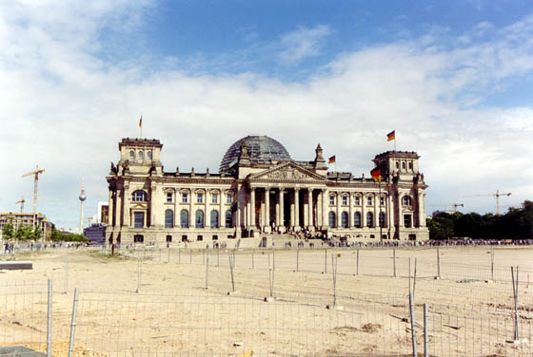
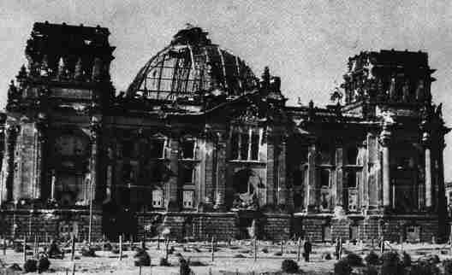
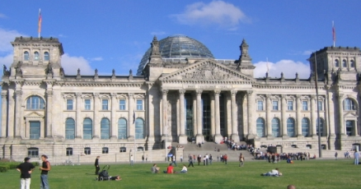
the life of the literary work
S₄
S₃
S₂
S₁
S₄
S₃
S₂
S₁
S₄
S₃
S₂
S₁
S₄
S₃
S₂
S₁
S₄
S₃
S₂
S₁
S₄
S₃
S₂
S₁
S₄
S₃
S₂
S₁
S₄
S₃
S₂
S₁
S₄
S₃
S₂
S₁
S₄
S₃
S₂
S₁
S₄
S₃
S₂
S₁
S₄
S₃
S₂
S₁
S₄
S₃
S₂
S₁
S₄
S₃
S₂
S₁
S₄
S₃
S₂
S₁

Slide 42
Can we fit software into this account of cultural objects?
Software = that which humans write

Slide 43
definitions of ‘software’
Programs, procedures, rules, and any associated documentation pertaining to the operation of a system. Contrast with hardware.
More narrowly: A program or set of instructions that controls the operation of a computer.
An ordered sequence of written out instructions that controls the operation of a computer for a specific purpose.

Slide 44
marks of the work of software
it is created (thus not an abstract Platonic entity)
it can have copies
but it is not identical with any copy (a copy counts as a copy)
it is an ordered written sequence (a created pattern)
it can be read
the readings (software inspection) unfold in real time
the events represented (instructed) unfold in represented (idealized execution) time

Slide 45
further marks of the work of software
it may be physically performed (on a machine)
it may be mentally performed (I imagine its execution)
the program work is not identical with any execution
the program is not identical with any copy of the code

Slide 46
concretization
  Programs must be written for people to read and only incidentally for machines to execute. (Abelson & Sussman 1989)
  Software execution vs. musical performance (role of score)
  Software execution vs. theatrical performance (role of instructions)

Slide 47
executable entity work of literature work of music work of drama recipe choreographic script film script service book route plan piece of software | execution reading performance performance act of cooking dance film religious rite funeral procession execution

Slide 48
Conclusion
a piece of software is an entity of the same ontological category as a work of dramatic art
it is an abstract pattern of instructions that is at the same time a historical created entity
with concretizations (readings), and executions, and an underlying script or score

Slide 49
Does this neglect the mathematical features of software
a piece of software ought to run on a computer
has mathematical properties
which need to be dealt with
perhaps God could apprehend the language-free essence of the piece of software from this strictly mathematical point of view

